Slide 1
ARC BITA Geek Seminar
Prof Lynn Woodward
Chair QUT Human Research Ethics Committee
l2.Woodward@qut.edu.au
humanethics.@qut.edu.au

Slide 3
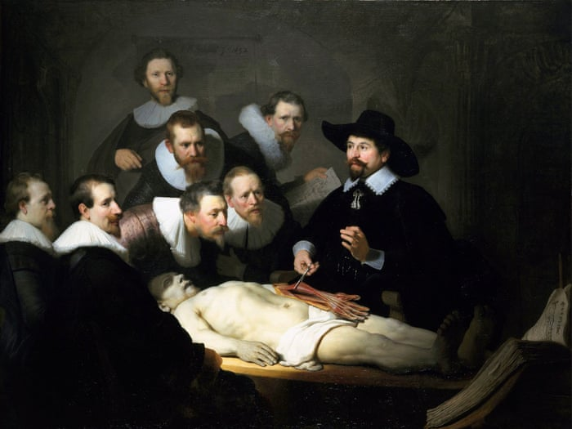
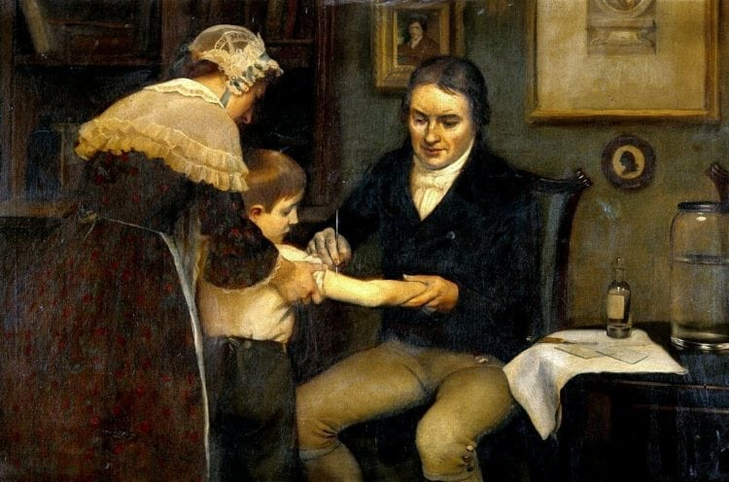
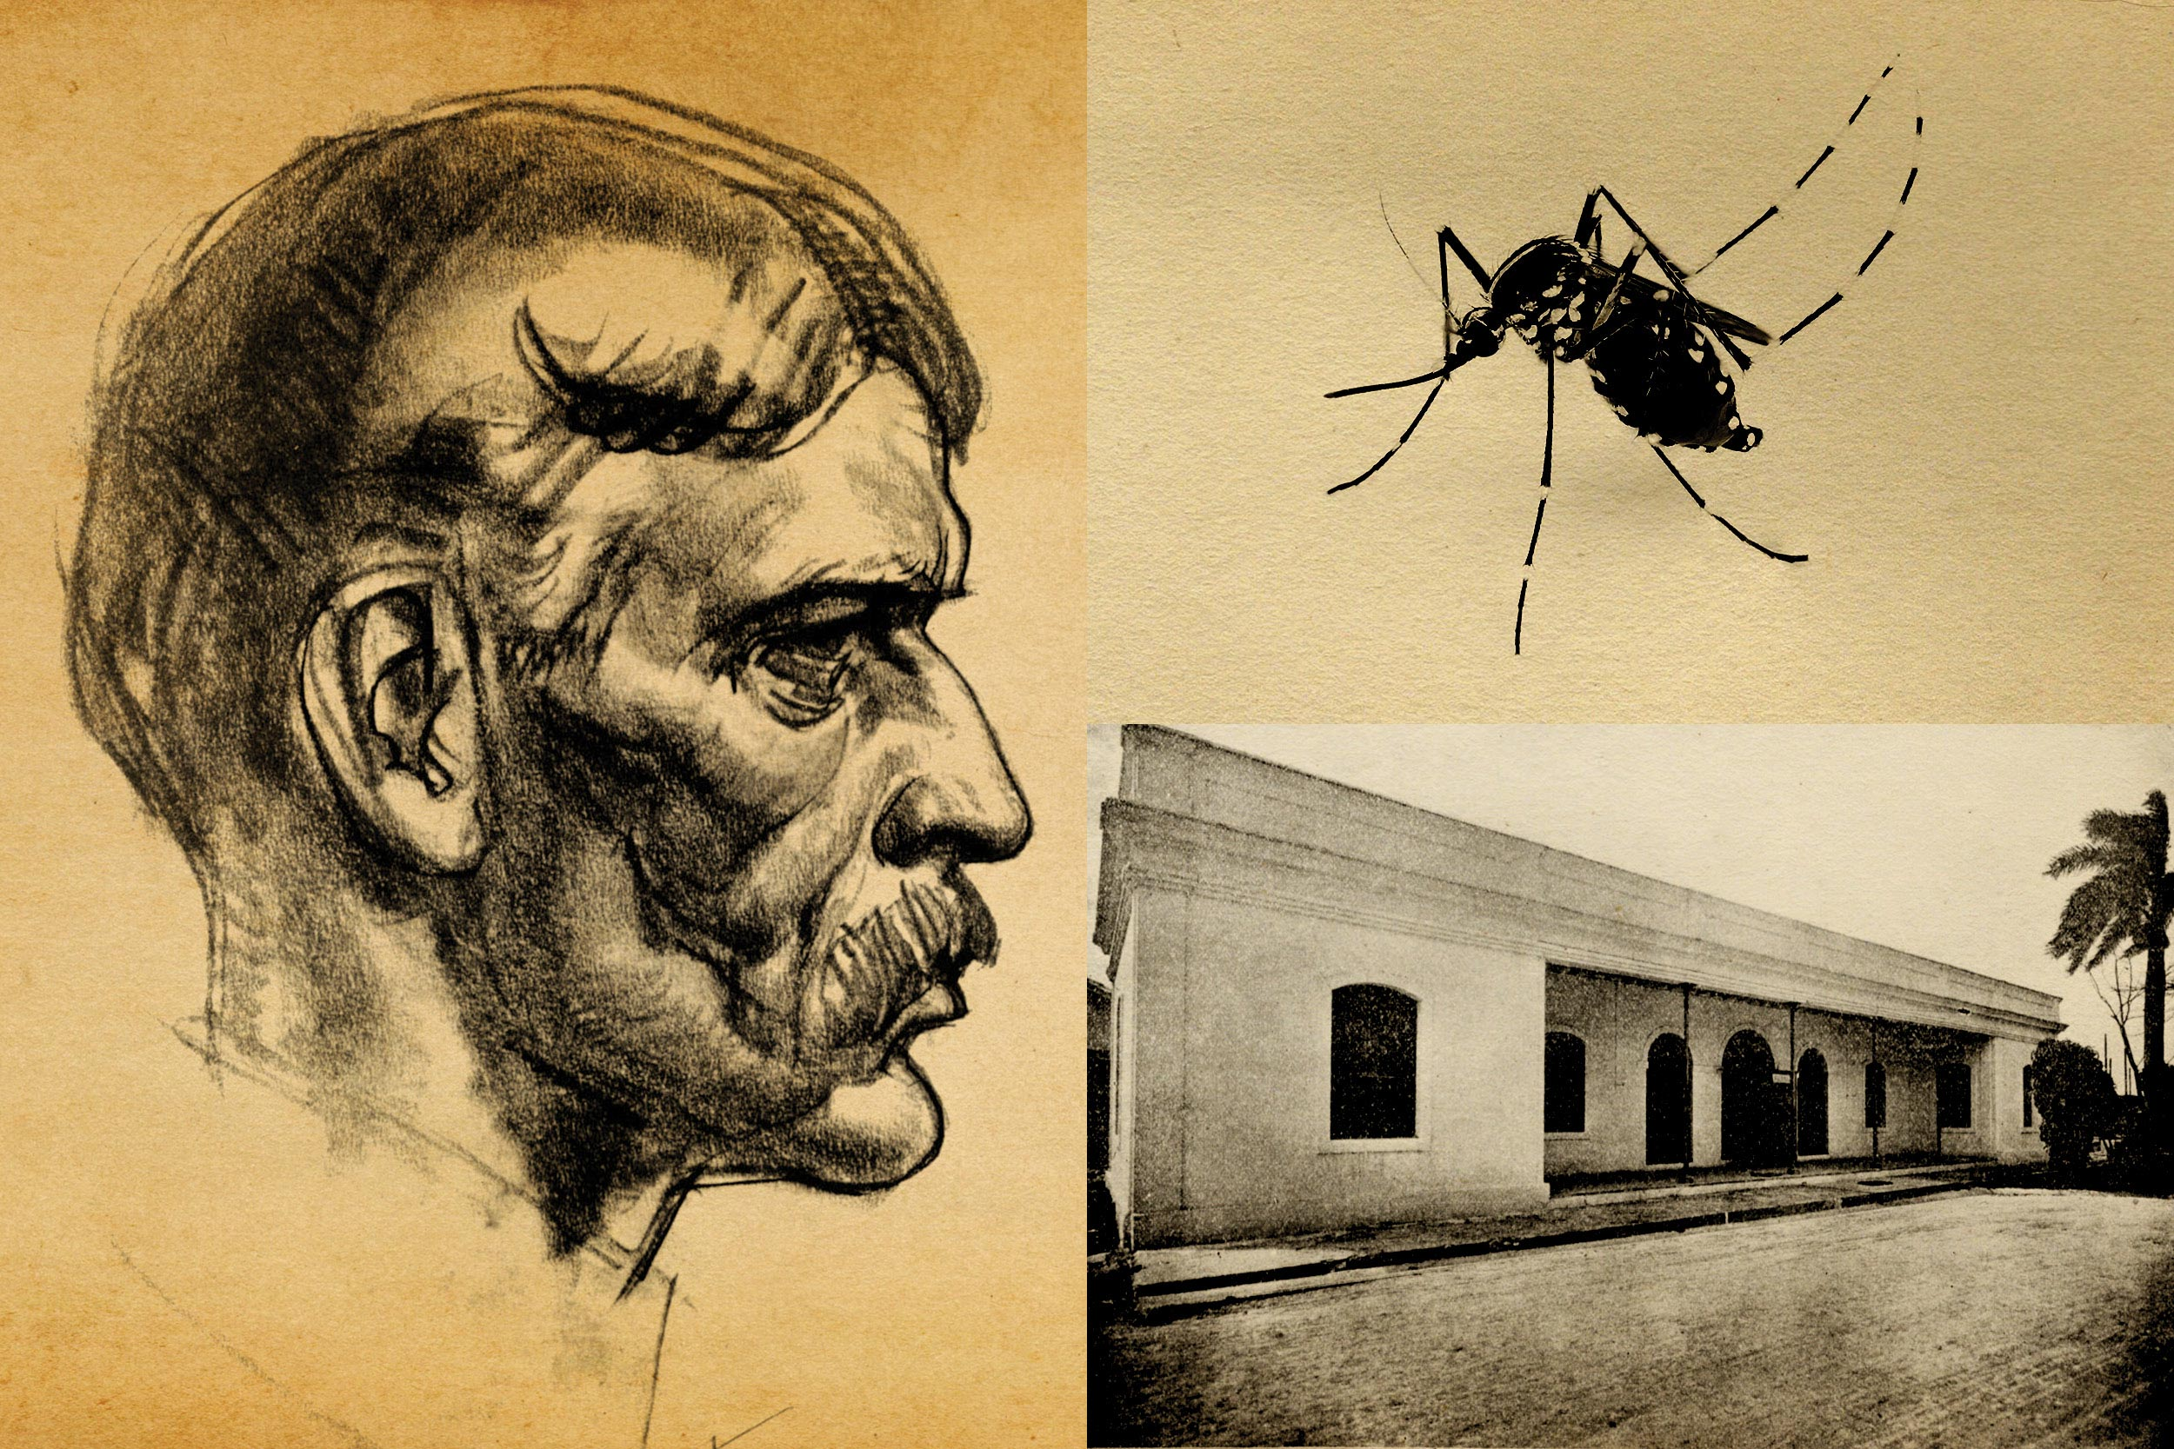
Human research – a brief, and selective, history
Observation
16th & 17th century – cadaveric research
Edward Jenner – small pox vaccine 1790s
Yellow fever
Giuseppe Sanarelli
Walter Reed
Informed consent
By today’s standards may consider unethical
Vulnerable populations – orphans, disabled, prisoners, migrants
Questionable consent

Slide 4

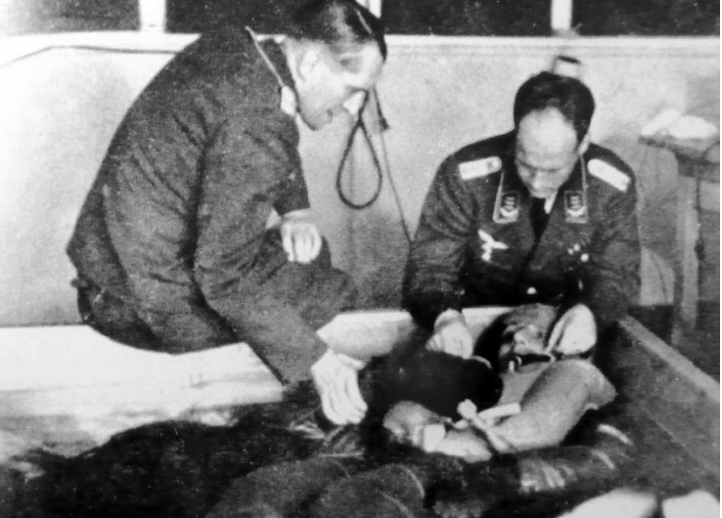

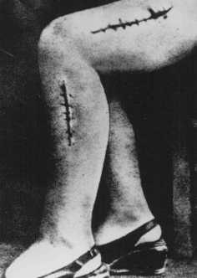
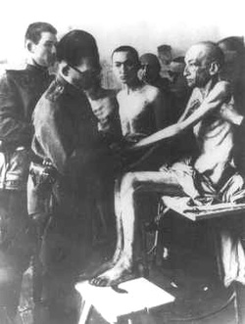

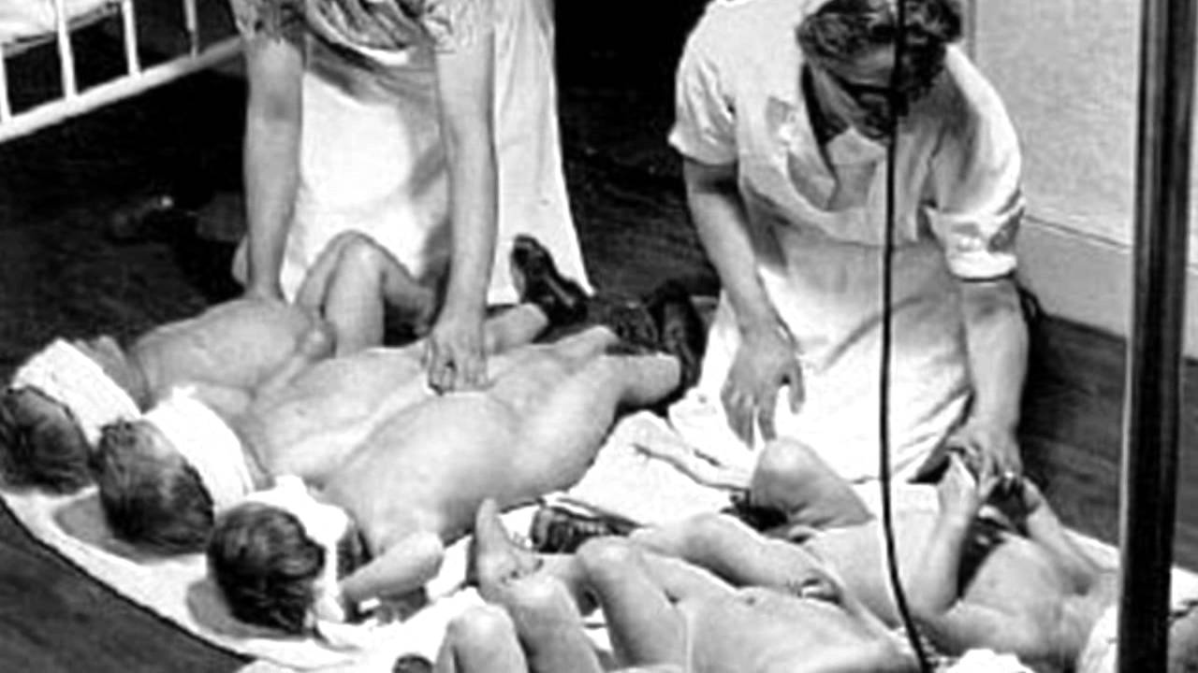
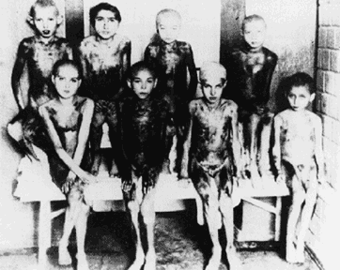
Nazi Medical Experiments WW2

Slide 5
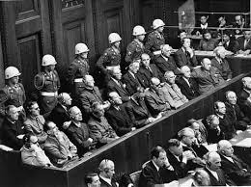
Nuremberg Doctors’ Trial

Slide 6
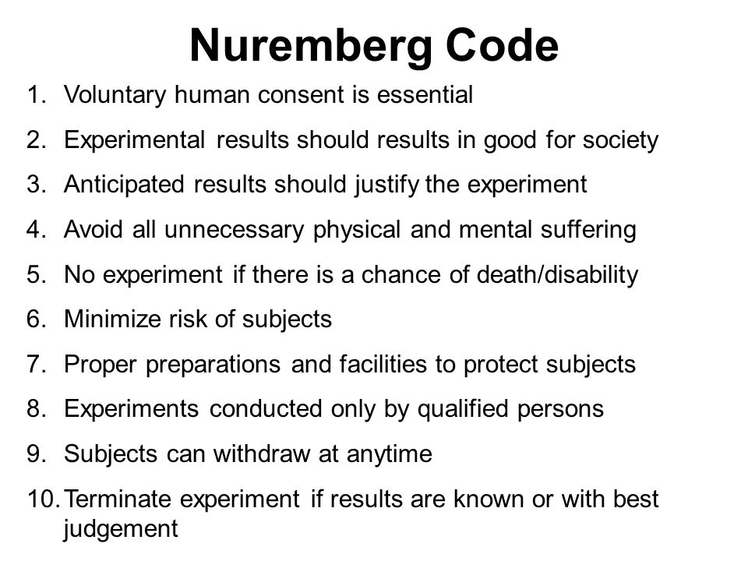

Slide 7
Human Ethics Guidelines
Nuremberg Code (1947)
Largely ignored
Declaration of Helsinki (1964) - World Medical Association
Council for International Organizations of Medical Sciences (CIOMS) (2002)
Council of Europe – Oviedo Convention (1997)
National Commission for the Protection of Human Subjects of Biomedical and Behavioural Research - Belmont Report (1974)

Slide 8

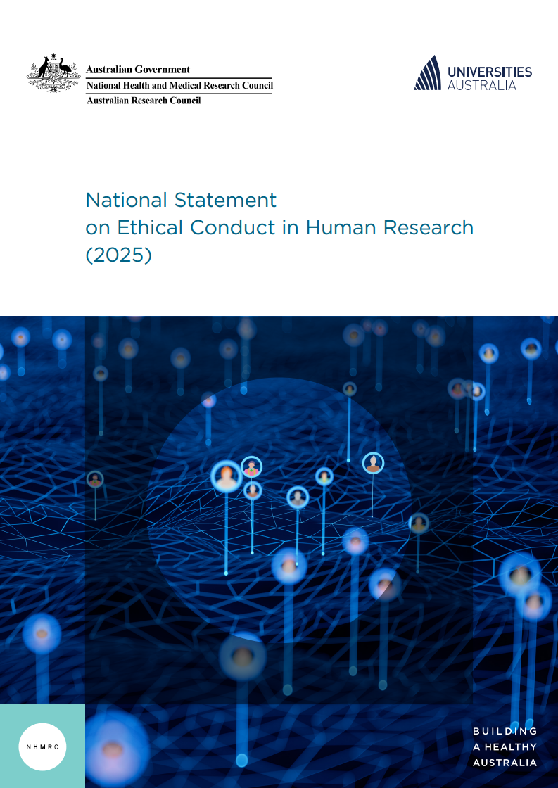
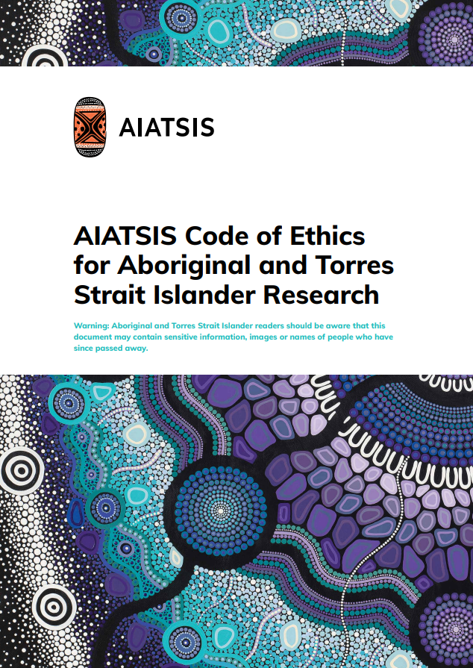
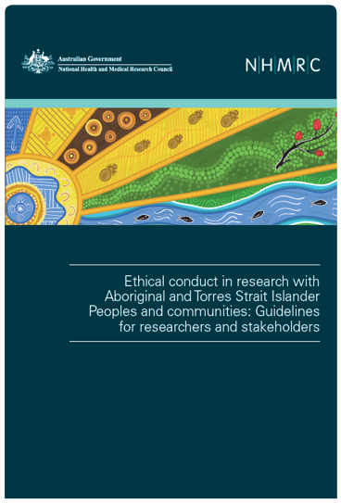
Important Codes and Statements

Slide 9
Australian Code for Responsible Conduct of Research
The Australian Code for the Responsible Conduct of Research provides a national framework for ensuring that research is conducted with integrity, professionalism, and accountability. It was developed collaboratively by the National Health and Medical Research Council (NHMRC), the Australian Research Council (ARC), and Universities Australia.
Honesty: Ensure truthfulness in proposing, conducting and reporting research
Rigour: Apply high standards in research design, methodology, analysis and interpretation
Transparency: Disclose interests, methods and findings openly; manage conflicts of interest appropriately
Fairness: Treat colleagues, collaborators and participants equitably, including in authorship and acknowledgement
Respect: Uphold the dignity, rights and autonomy of research participants and communities
Recognition: Acknowledge the rights of Aboriginal and Torres Strait Islander peoples to be involved in research that affects them
Accountability: Comply with relevant legislation, policies, and ethical guidelines
Promotion: Foster responsible research practices within institutions and teams.

Slide 10

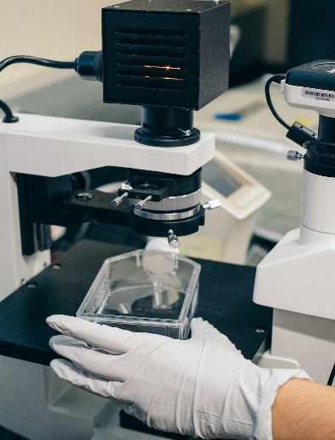

WHAT IS HUMAN RESEARCH?
“Research with or about people, their tissue or data”
Conducting:
surveys
interviews
focus groups
observations
Collection or use of:
bodily organs
cell lines
tissues
fluids
Access to:
personal information
documents
data sets
social media data
If your project touches people’s lives, it likely needs ethics review.

Slide 11
What is not human research – watch this space….
Literature review
Research using public data – e.g. information that has been published, or information that has entered the public domain with the consent of the person(s) with whom the information is associated
Research using aggregate data

Slide 12
National Statement
Section 1 Values and principles of ethical conduct
Section 2 Themes in research ethics: risk and benefit, consent
Section 3 Ethical considerations in the design, development, review and conduct of research
Section 4 Ethical considerations specific to participants in research
Section 5 Research governance and ethics review

Slide 13
National Statement
Values and Principles (Chapter 1)
Research merit and integrity
Justice
Beneficence
Respect
Themes (Chapter 2)
Risks and benefits
Informed consent

Slide 14

National Statement on Ethical Conduct
in Human Research 2025
Merit and integrity
Justifiable by its potential benefit
Based on current literature
Researcher experience, qualifications
Methods appropriate for aims
Contribute to knowledge and understanding
Justice
Inclusion/exclusion criteria, fair
Fair recruitment
Fair distribution of benefits
Results available to participants
No unfair burden
Beneficence
Designed to minimise harm
Is the project beneficial
Risks managed & disclosed
Benefits outweigh any risks
Fair access to benefits
Respect
Respect capacity to decide
Provide sufficient information
Respect privacy & confidentiality
Voluntary choice
Protects cultural sensitivities

Slide 15
NS Chapter 3 Ethical considerations in the design, development, review and conduct of research
NS 3.1 – 7 elements common to most research
Research Scope, aims, themes, questions and methods
Recruitment
Consent
Collection, use and management of data and information
Communication of research findings or results to participants
Dissemination of research outputs and outcomes
After the project

Slide 16
What is human research?
Conducted with or about people, or their data or biospecimens
Surveys, interviews, focus groups
Testing or treatments
Observation
Collection and use of biological materials
Access to their individual information in identifiable, or potentially re-identifiable form

Slide 17
Data and Information (NS Section 3, Element 4)
What people say in interviews, surveys etc
Images, audio recordings
Records generated for administrative purposes
Digital information, such as that generated through use of mobile devices
Information generated by analysis of existing personal information
Observations
Material, comments, images etc that are published or publicly accessible
Social media posts
Online forums
Public datasets

Slide 18
Cambridge Analytica
Researcher developed Facebook app - This is your digital life
Personality quiz – users were paid to take the test, consented to share their data
But permissions also allowed it to collect data from users’ Facebook friends
More than 50 million Facebook profiles accessed without consent
Cambridge Analytica obtained with data
Psychological profiles
Used for targeted advertising, including in political campaigns

Slide 19
Publicly available data – ethical consideration
Respect for autonomy – consent
Secondary use of data – individual may not have had reasonable expectation that data would be used in research
Risk of re-identification

Slide 20
Waiver of consent NS 2.3.10
Low risk
Benefits outweigh risk of harm of not getting consent
Impracticable to get consent
No reason to think individual wouldn’t consent
Protection of privacy
Plan to protect confidentiality
Plan for return of significant findings
Commercial exploitation
Waiver not prohibited by law
NS 2.3.11 – If research plans to expose illegal activity

Slide 21
Justifying waiver
Impracticable to get consent
Not just hard, but impractical
100 people – hard, 20 000 probably impracticable
Consider if participants were elderly or ill – harms in trying to contact
No reason to think individual wouldn’t consent
Consumer involvement in development of project may help HREC determine this

Slide 22
Australian Privacy Principles – Australian Privacy Act (1988)
Open and transparent management
Anonymity and pseudonymity
Collection of solicited personal information
Dealing with unsolicited personal information
Notification of collection
Use or disclosure
7. Direct marketing
8. Cross-border disclosure
9. Government identifiers
Quality of personal information
Security
Access
Correction

Slide 23
Myki card data research
1.8 billion ‘touch on’ and ‘touch off’ events from 15 million Myki cards covering 2015-2018
Exact timestamps
Location of events
Card type (student, police etc)
Linked trips for each card
Researchers from U of Melbourne showed that
2 known trips often enough to uniquely identify a person in the dataset
Could then extract full travel history for 3 years, home and work locations, co-traveller patterns
PTV in breach of the Privacy and Data Protection Act Victoria

Slide 24
Decreasing identifiability of data
Remove unique identifiers
name, address etc
Mask indirect identifiers
Use age or age range, not date of birth
Use postcode rather than street name
Aggregate data
Treat small data sets with care
Remove linkage keys

Slide 25
Ethics application types through the ERM platform
Lower risk applications
- Foreseeable risk is no greater than discomfort (NS 2.1)
- Submit on the Human Ethics Low Risk Application form for Faculty review (Faculty Ethics Chair & School Research Ethics Advisor)
Committee applications
- Higher risk research (risk greater than discomfort) &/or involves participants who may experience increased risk due to their circumstances or the context of the research
- Submit on the Human Research Ethics Application (HREA) form (developed by the NHMRC) for Faculty pre-review & UHREC review
Variations For minor changes to an approved lower risk or HREA applications
Administrative Reviews
- Study approved by another Australian NHMRC registered HREC
- Research approved by an ethics review body in USA, Canada, NZ or UK (other countries on a case-by-case basis)
Lower risk
Conducted overseas & QUT staff are involved
Study documentation, correspondence & approval provided
Abide by QUT policies
- OREI Research Integrity Officer will review to ensure University governance requirements are met
Exemptions (see OREI “Apply for approval” page)
- Research that carries a lower risk to participants/community & satisfies one or more of the sub-clauses in NS 5.1.17
- Complete the Human Ethics Exempt Research Application before commencing research
- OREI Research Governance office will review
- Must be ethically acceptable
Sub-forms
- Concerns, complaints & adverse events – unexpected events sub-form
- Progress/annual & final reports – progress/final report sub-form
Notes:
Exempt
Lower risk to participants and satisfies one or more of the following:
Information or data where identifiers have been removed prior to researcher receipt (sub-clauses about re-identification at NS 5.1.17)
Surveys & observation of public behaviour (recorded without identifiers & research/outcomes unlikely to cause distress)
Educational training/outcomes for program use only
Publicly available information, through mechanism set out by legislation & is protected by law (registries births, deaths; coronial investigations; ABS; mandatory reporting information)
Admin review
The research project must have been approved by an ethics review body in one of the following countries, which have been chosen by OREI due to some know similarities in terms of ethical regulations and oversight:
USA
Canada
New Zealand
United Kingdom
The overseas body must have determined the research to be low risk (or equivalent term, for a study that does not pose a foreseeable risk of harm to participants, communities, or society).
QUT researchers must be able to provide all of the approved study documents, including the ethics application and approval letter.
QUT researchers must be named on the approved application.
QUT researchers must agree to abide by all QUT policies in undertaking the research – for example, in respect of data management.
The research must only be conducted overseas, the research must not involve recruitment or study sites within Australia.

Slide 26

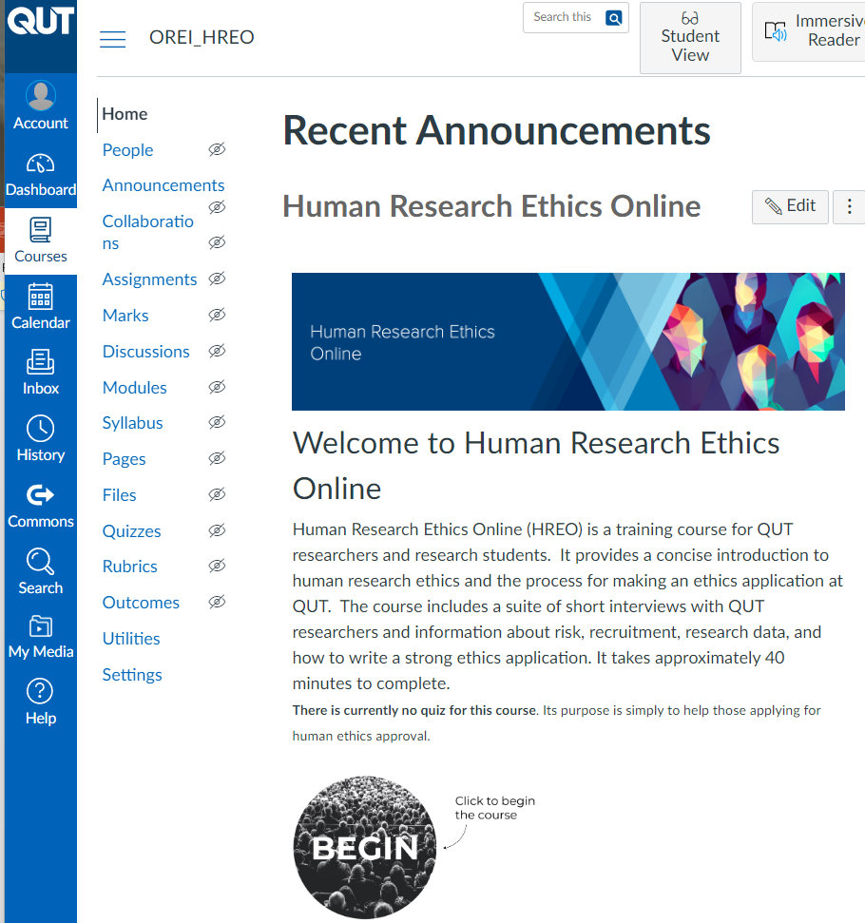
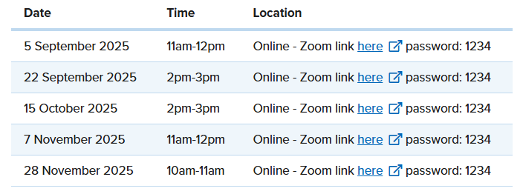
Human Research Ethics Online
For staff and students
Concise introduction to human research ethics: examples from multiple faculties
Approximately 40 minutes to complete
Self-enrol in this course in Canvas
FAQs for applicants
Training
‘Introduction to Human Research Ethics’ Lecture
For staff & students who conduct, or plan to conduct research involving human participants, their data or tissue.
Covers application process, an overview of ethical considerations, QUT policy, and national guidelines.
Customised training for groups may also be available through Human Ethics
Book an Ethics Consultation
Can book an appointment with an Ethics Liaison Officer if you have specific questions about preparing your research ethics application – See HiQ/DW
It is strongly recommended that you attend the ‘Introduction to Human Research Ethics’ lecture before attending this session.

